Slide 1

@zinecat
Zine Union Catalog
A Brief History of Presentations Given by Lauren and Jenna During the MADH Program

Slide 2
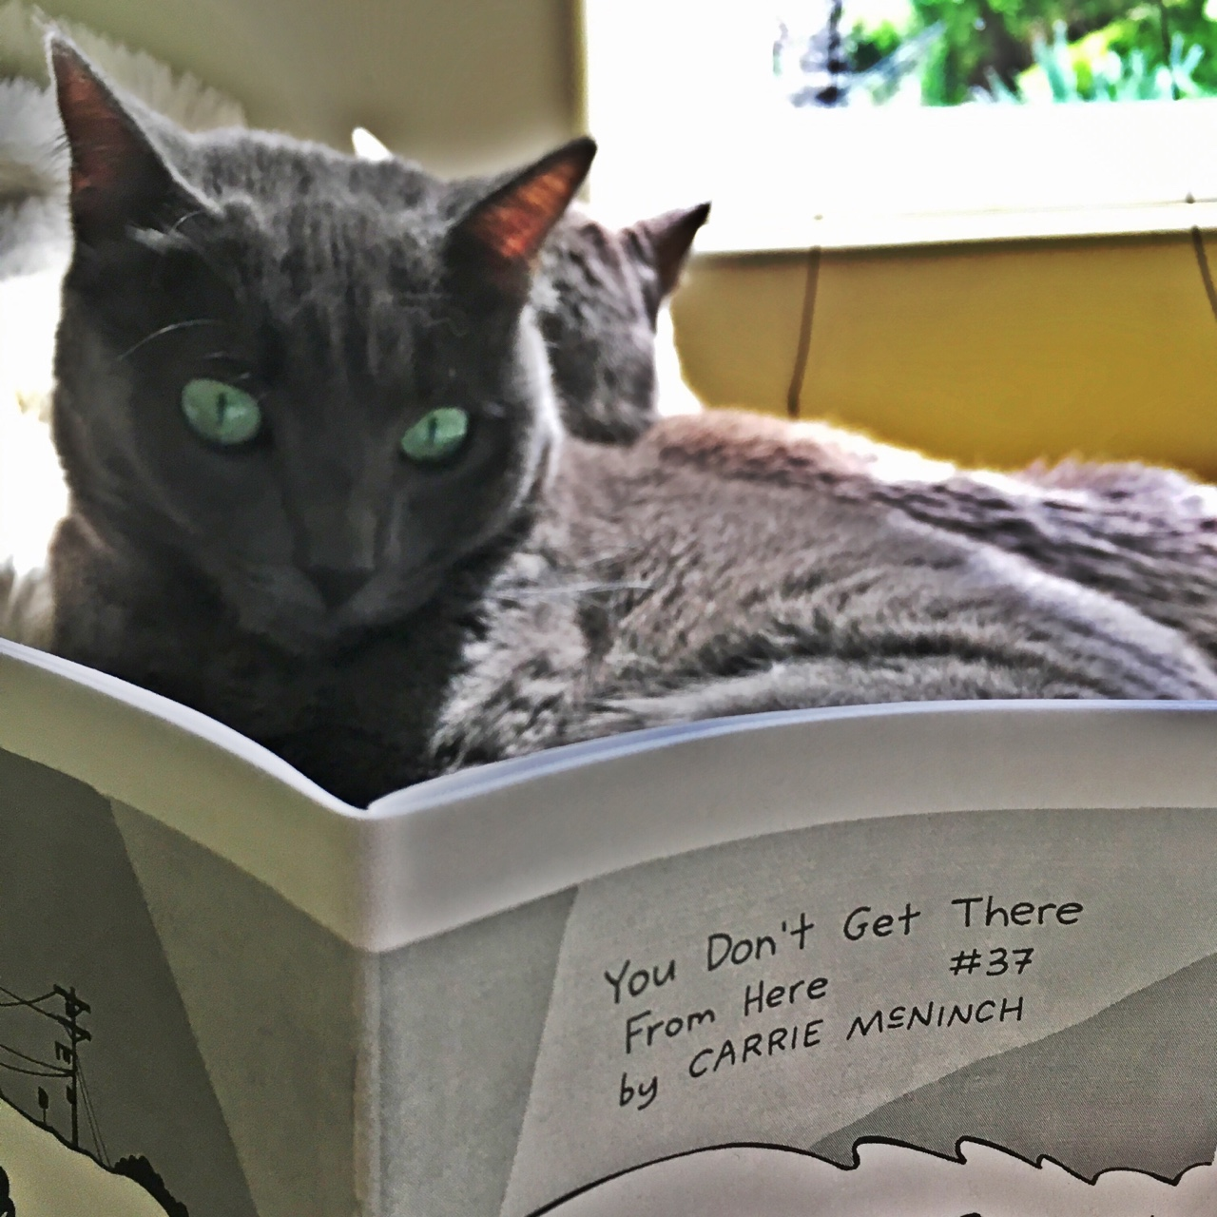
@zinecat #digitalgc
CUNY Graduate Center Digital Showcase
New York, NY - May, 2018
A year after the ZineCat team presented on their accomplishments from the Digital Humanities Praxis course, Lauren presented an update to the greater GC community on the work completed during the Interactive Technology & Pedagogy courses. At this point, focus on developing the project was on:
Project management
Decision-making
Grant writing
Reconnecting/reporting back to zine librarians

Slide 3
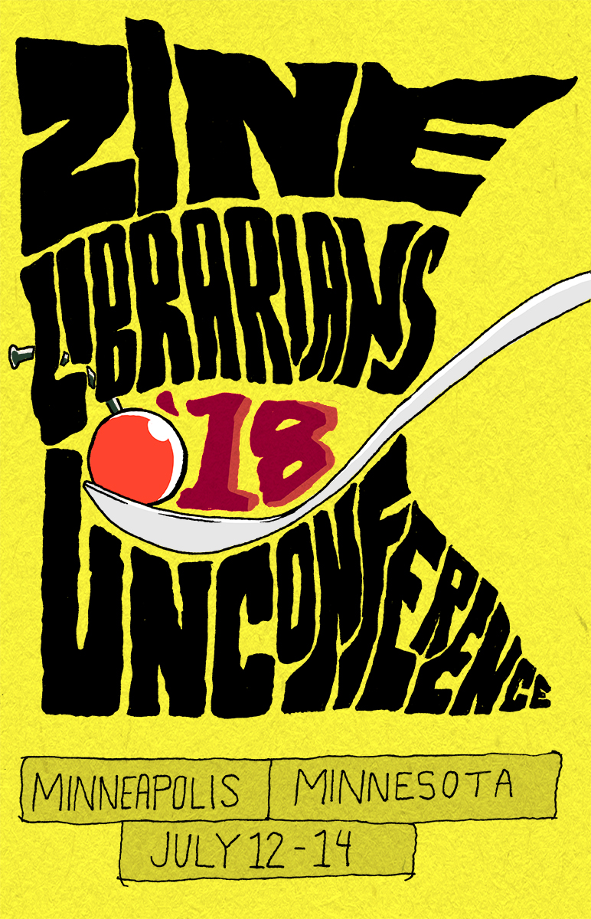
@zinecat #zluc
Zine Librarians unConference (ZLuC)
Minneapolis, MN - July, 2018
During ITP Core II, Jenna and Lauren planned to present three sessions at ZLuC. All three were accepted.
Overview (for those familiar and unfamiliar)
Priorities (decision making/shared authority, accessibility, mutual metadata, ingests, design of the interface, & grant writing)
Hack ZineCat (breakout groups to work on the priorities)

Slide 4
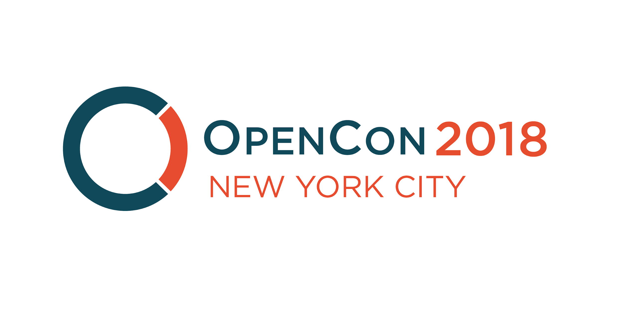
@zinecat #OpenConNYC18
NYC Open Con
New York, NY October, 2018
Zine Union Catalog: A DIY Open Culture Community in Print - Jenna and Lauren will present on the ongoing development of the The Zine Union Catalog (ZUC) evolving through their work at the CUNY GC. Participants will receive an overview of the project and catalog, how it's developed, where it's headed, and how the project both used an open source DAM platform to aggregate open data and how the project grapples with the problems inherent in sharing information online (i.e. with respect to zine author anonymity, etc.). Participants will also be introduced to the Zine Librarians Code of Ethics and will make their own zines about the OpenCon 2018 as well as create metadata for their zines.

Slide 5

@zinecat #nycdhweek19
NYC DH Week
New York, NY February, 2019
Jenna presented a lightning talk on her work as a Zine Librarian at Barnard. Her work on the Zine Union Catalog was summarized at the end of the presentation.
“To you ‘librarian’ and ‘archivist’ may seem like minor differences. To me the differences are greater than ‘English professor’ and ‘history professor.’”
“It does mean that I love catalog records more than finding aids. As a librarian, in addition to being catalog-centric, I'm also involved with CIRCULATING collections. My creators are alive and my documents are under copyright.”

Slide 6
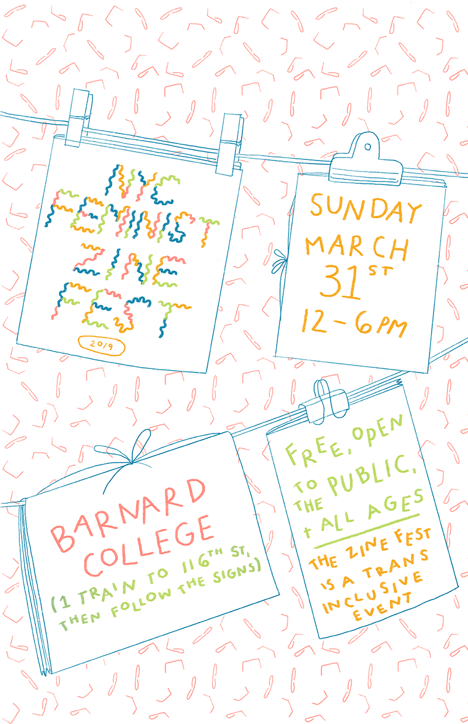
@zinecat #fzfnyc
NYC Feminist ZineFest
New York, NY March, 2019
10 minutes soapbox chat.
Zinecat.org is a union catalog dedicated to zines! A union catalog is a resource where libraries can share cataloging and holdings information. The Zine Union Catalog (ZUC) lets researchers discover zine holdings by searching a single catalog, and helps librarians copy catalog records to facilitate lending across libraries. ZUC serves educators, researchers, librarians, archivists, and anyone in the general public with an interest in zines.

Slide 7

@zinecat #NYULibrary
NYU Division of Libraries Digital Show-n-Tell
New York, NY April, 2019
5 slides in 6 minutes with 9 minutes for Q&A. Lauren participated in a show-n-tell to her NYU Libraries colleagues. Presented an overview of the Zine Union Catalog and how other digital humanities tools/theories have been incorporated into developing ZineCat. Discovered that another colleague is using Collective Access to build a collection of digital texts, NYU Libraries provides support and access to Reclaim Hosting, and that metadata harmonization is not just difficult for ZineCat!

Slide 8
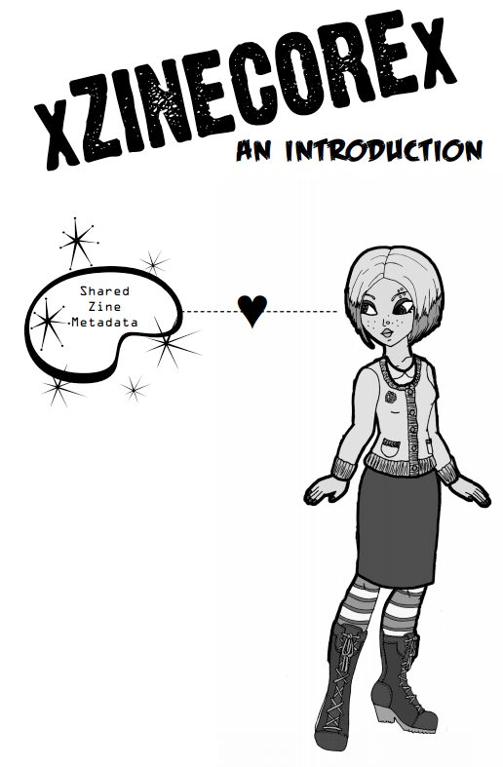
@zinecat @zinelib
ZUC at University of Wisconsin, Madison
Madison, WI Spring, 2019
http://lowereastsidelibrarian.info/talks/2019/uwmilwaukee
What's Your Analog Doing in My Digital Humanities? is the title of Jenna’s presentation where she provided an overview of ZUC, zine pedagogy, and Barnard’s unique collection for UWM’s Bending the Archive: Zines, Archiving, and the Digital Humanities. "Finally, in the case of the Barnard College Zine Library, one encounters the case of a collection that has an explicit digital mandate but one focused on cataloguing rather than the transfer of printed documents into a digital format." - Eichhorn, Kate. 2014. “Beyond Digitisation: A Case Study of Three Contemporary Feminist Collections.” Archives and Manuscripts 42 (3): 227–237.

Slide 9

@zinecat #zinepavilion
Zine Union Catalog Workshop at ALA Annual 2019
Washington, DC June, 2019
This session, held in the Zine Pavilion (booth 2947) on Sunday, June 23 from 12-1pm, is about ZineCat (work-in-progress), a union catalog dedicated to zines! It brings together holdings from disparate libraries with divergent metadata schema. The zine union catalog attempts to harmonize, rather than normalize and find mutuality, rather than control of creators and descriptors. The catalog is built on the open access platform Collective Access and is made with zine creators in mind, as much as catalogers and researchers. We’re still just at the prototype stage and embrace new contributors and contributions!

Slide 10

@zinecat #zluc
Zine Librarians unConference (ZLuC)
Salt Lake City, UT - July, 2019
Friday, July 19th Zine Union Catalog - YAK pt. 1
http://zinelibraries.info/wiki/zluc-2019-salt-lake/zine-union-catalog-part-1/
Friday, July 19th Zine Union Catalog - YAK pt. 2
http://zinelibraries.info/wiki/zluc-2019-salt-lake/zine-union-catalog-part-2/

Slide 11

@zinecat #ComputersInLibraries
Computers in Libraries
Washington, DC April, 2020 (proposed)
Herding Catalogs & Harmonizing Heavy Metadata: Building the Zine Union Catalog - Presenters Jenna Freedman and Lauren Kehoe, in collaboration with other zine librarians, developed a union union catalog for zines, ZineCat. The catalog is built in the open source DAM, CollectiveAccess, and harmonizes disparate metadata from six collections: one public library, one academic library, one academic archive, two community zine libraries, and one digital zine library and archive. Jenna and Lauren will present on the ongoing development of ZineCat. Participants will receive an overview of the project and catalog, how it's developed, where it's headed, and how the project both used an open source DAM platform to aggregate open data and how the project grapples with the problems inherent in sharing information online (i.e. with respect to zine author anonymity and identities, etc.). Participants will also be introduced to the Zine Librarians Code of Ethics and will make their own zines, as well as create metadata for their self-publications.

Slide 12
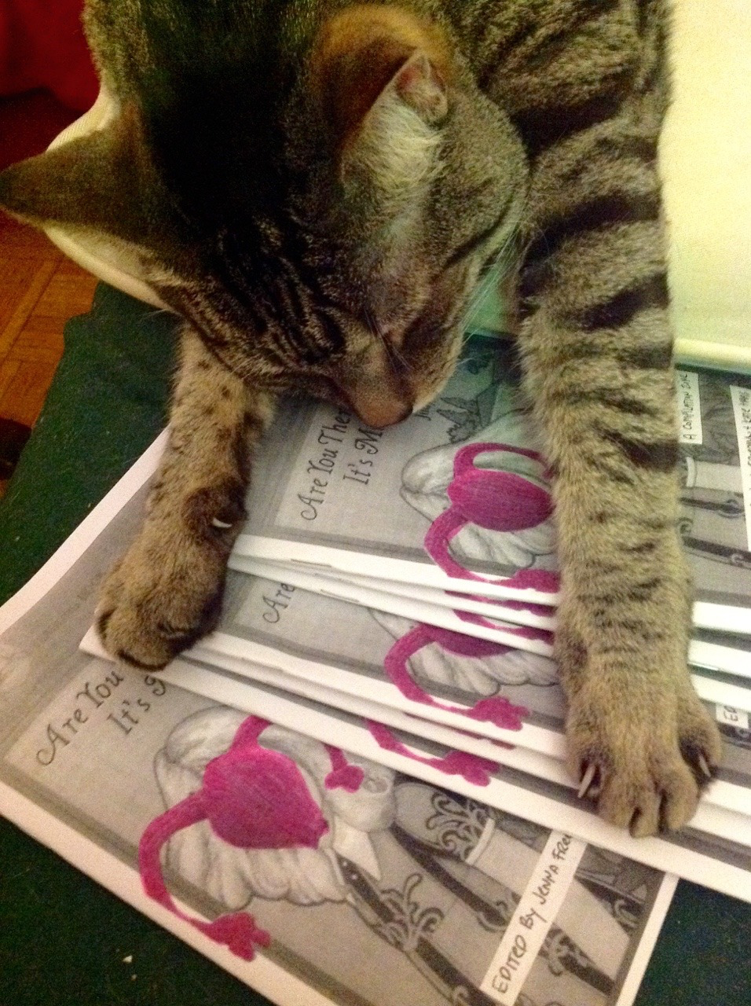
@zinecat

